Slide 1
International Conference On Innovations In Science,Engineering And Technology 2022
(ICISET-2022)
Securing Certificate Management System Using Hyperledger Based Private Blockchain
Paper ID: 50
Authors:
Saha Reno
Mamun Ahmed
Saima Ahmed Jui
Shamma Dilshad (Presenting Author)

Slide 2
CONTENTS
Introduction
Literature Review
Problem Statement
Objectives
Proposed Approach
Methodology
Result Analysis
Conclusion & Future Recommendation
ICISET 2022
Paper Id: 50

Slide 3
INTRODUCTION
A blockchain is a decentralized, shared, and frequently open immutable ledger made up of blocks that are used to record transactions across multiple computers.
Hyperledger blockchain which is an open source and private blockchain and everyone can not access every part. It has permissioned mode of operation and is used to build enterprise blockchains.
ICISET 2022
Paper Id: 50

Slide 4
LITERATURE REVIEW
Authors | Contribution | Limitation
Haya R. Hasan, Khaled Salah, Raja Jayaraman | Blockchain-based Solution for COVID-19 Digital Medical Passports and Immunity Certificates. | Bitcoin and Ethereum based certificate system.
Mahmudul Hasan, Anichur Rahman, and Md. Jahidul Islam | A Distributed Secure Blockchain based Online Certificate Verification System from Bangladesh Perspective. | Didn’t propose architecture for the graduate in the various stages and also evaluation of performances isn’t presented in numerous parameters.
Irawan Afrianto, Yayan Heryanto | Design and Implementation of Work Training Certificate Verification Based On Public Blockchain Platform. | The system is more complicated, and using Ethereum transactions is much slower in this system.
ICISET 2022
Paper Id: 50

Slide 5
LITERATURE REVIEW
Authors | Contribution | Limitation
Jiin-Chiou Cheng , Narn-Yih Lee, Chien Chi, and Yi-Hua Chen | Blockchain and Smart Contracts for Digital Certificates. | The system is more complicated, and using Ethereum transactions is much slower in this system.
Grather, Wolfgang Kolvenbach, Sabine Ruland, Rudolf Schutte, Julian Torres, Christof Wendland, Florian | Blockchain for education: Lifelong learning passport | The whole system is considered insecure as Ethereum is a public and permissionless blockchain and therefore, anyone can access the certificates.
Kolvenbach, Sabine Ruland, Rudolf Grather, Wolfgang Prinz, Wolfgang | Blockchain 4 Education | This platform is based on the Ethereum blockchain and uses smart contracts. This system suffers from the same issues as the earlier paper.
ICISET 2022
Paper Id: 50

Slide 6
PROBLEM STATEMENT
The digitization of certificates is the major emphasis of certificate management.
Here, the certificate system is implemented using a hyperledger-based low-cost and private blockchain.
The Hyperledger blockchain can prevent certificate falsification and duplication.
ICISET 2022
Paper Id: 50

Slide 7
OBJECTIVES
This hyperledger based system limits user access in various ways, but the owner has full access to all certificate management operations.
The assets created by conducting transactions become immutable in nature, thus preserving the transparency and accountability of the certificate management system.
This technology gives significantly more security due to its decentralized and traceable nature.
ICISET 2022
Paper Id: 50

Slide 8
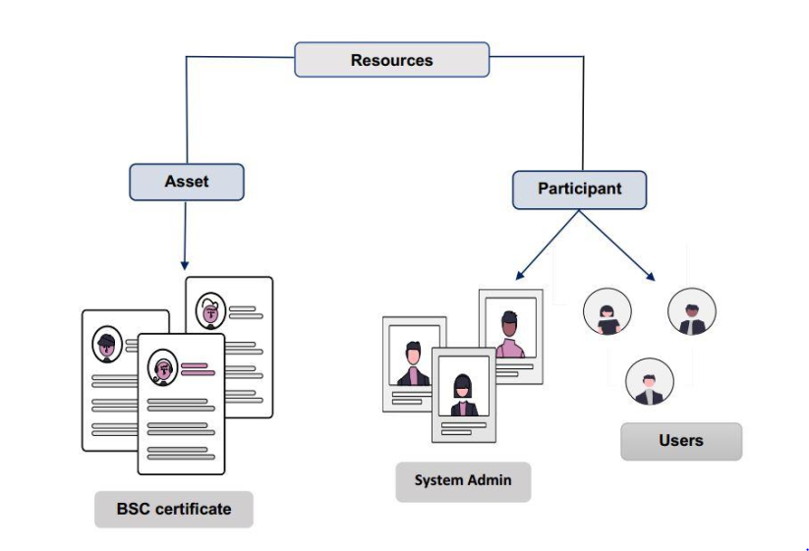
Necessary information will be collected from the user.
Admin creates a certificate asset.
Users have some constraints while using the system.
Every certificate asset has an asset ID.
PROPOSED APPROACH
Figure-1: System Approach
ICISET 2022
Paper Id: 50

Slide 9
METHODOLOGY
1. Create Assets
2. Execution of Transaction
3. Determine Participant Types
4. Maintain Assets in Asset Registry
5. Transactions from the Historian Records
6. Transaction Query in Historian Records
7. Establishing Privacy Setting Regulations
ICISET 2022
Paper Id: 50

Slide 10
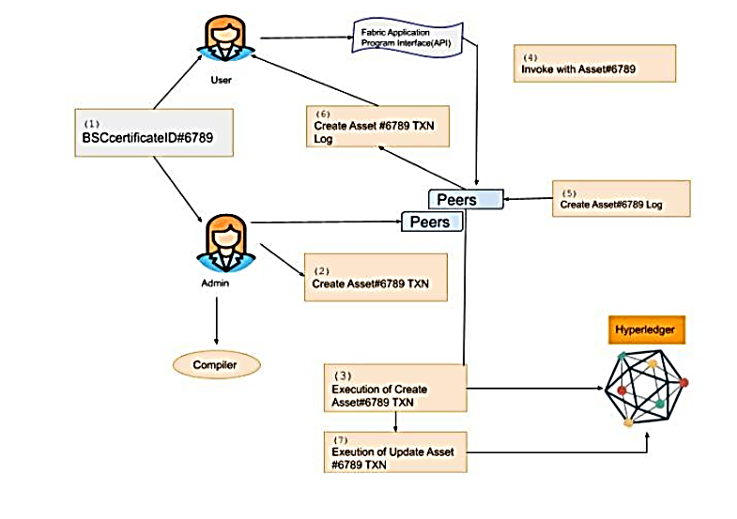
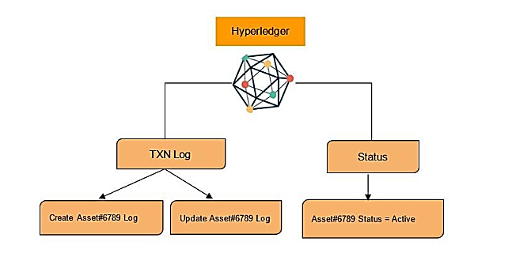
METHODOLOGY
Figure-2: System Information Flow and Interaction With Blockchain
ICISET 2022
Paper Id: 50

Slide 11
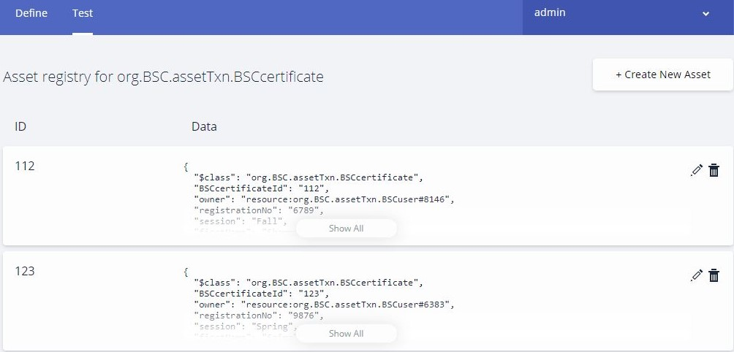
RESULT ANALYSIS
Admin creates the assets and all of our system's assets information will be retained in the asset registry. The asset registry will be adjusted whenever the admin introduces a new asset.
ICISET 2022
Paper Id: 50
Figure-3: Asset Registry For Certificate System

Slide 12
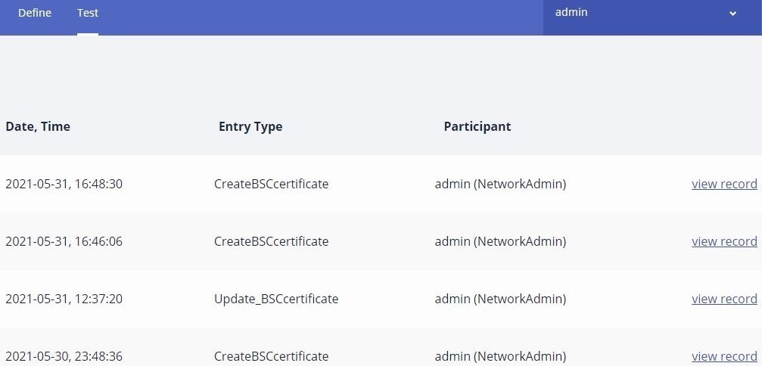
RESULT ANALYSIS
Figure-4: Historian Record
ICISET 2022
Paper Id: 50

Slide 13
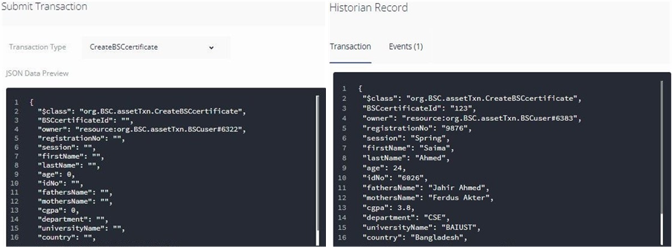
RESULT ANALYSIS
Figure-5: Create Transaction
ICISET 2022
Paper Id: 50

Slide 14
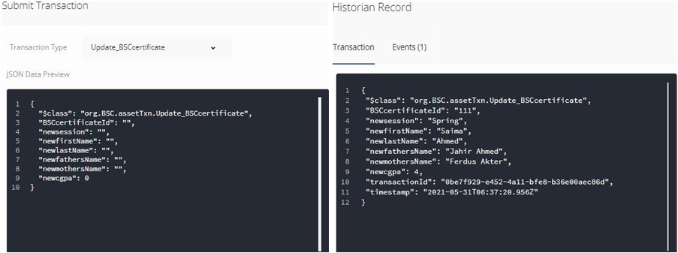
RESULT ANALYSIS
Figure-5: Update Transaction
ICISET 2022
Paper Id: 50

Slide 15
RESULT ANALYSIS
Table I: Time Needed to Execute Transactions in Various Blockchain Technologies
Number of transitions | Time for Hyperledger (In second) | Time for Ethereum (In second) | Time for Bitcoin(In second)
350 | 7.53 s | 40.9 s | 42.89 s
300 | 6.43 s | 32.89 s | 35.675 s
250 | 4.58 s | 25.5 s | 27.68 s
200 | 3.26 s | 19.85 s | 21.54 s
150 | 2.45 s | 12.9 s | 15.26 s
100 | 1.98 s | 5.35 s | 7.185 s
ICISET 2022
Paper Id: 50

Slide 16
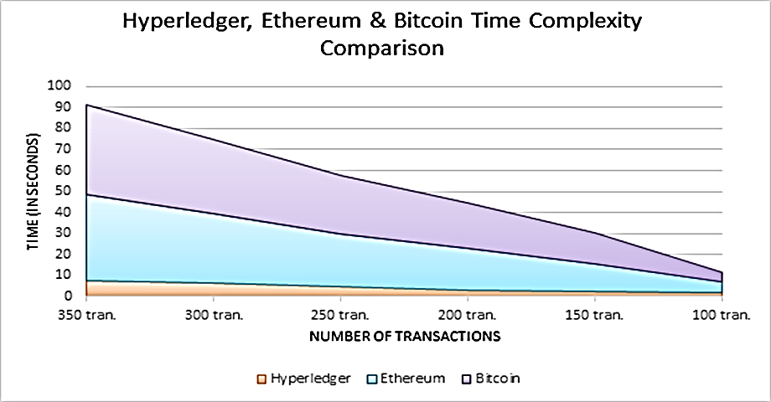
RESULT ANALYSIS
Figure-6: Comparison of Computation Time For Three Blockchain Systems
ICISET 2022
Paper Id: 50

Slide 17
CONCLUSION AND FUTURE RECOMMENDATION
The system is stable and more authentic.
Highly secure and cryptocurrency is prohibited.
Provide transparency and traceability of data shared across a network.
Compare to other system, hyperledger process more rapidly.
Hyperledger Sawtooth can be used to process parallel transactions in the future.
ICISET 2022
Paper Id: 50

Slide 18

Thank You!
ICISET 2022
Paper Id: 50

